Slide 1
Why Async?
Thessaloniki .NET Meetup (2017)
Notes:
Questions welcome!

Slide 2
The Async Revolution
Notes:
The async/await keywords are taking over the world!
Many people (like me) see this as a good thing.
Generally, people who have done asynchronous programming in the past welcome async/await.

Slide 3
The Async Revolution Invasion?
Notes:
But maybe that doesn’t apply to you (and that’s OK!).
Those who have not worked with asynchronous code before view async/await as problematic.
Async/await have a tendency to “infect” code, and if you’re new to asynchronous programming, it seems more like an invasion than a revolution.
Part of this talk is explaining why the async/await keywords are designed the way they are, and why they’re so troublesome.
My hope: that you can see async as an opportunity instead of a hinderance.

Slide 4
Async Invasion Timeline
Dart 1.9
2015-03
F# 2.0
C# 5.0
Hack (PHP)
Python 3.5
2010-08
2012-08
2014-03
2015-09
2010
2010
2011
2012
2013
2014
2015
2016
2012-08
2015-09
VB 11.0
TypeScript 1.6
Next:
JavaScript (“Async Functions” - stage 3 / Candidate)
C++ (n4134 “Resumable Functions” Proposal)
Notes:
JavaScript stage 3 is available (and fairly widely used) via Babel.
C++ proposal is only available in Microsoft’s C++ compiler.

Slide 5
The Concurrent Universe
Concurrent
Reactive (Event-Driven)
Multithreaded
Asynchronous
Parallel
Notes:
This slide is mostly about terminology, and there’s no definite standard or consensus yet.
I prefer to use the term “concurrency” for multiple things happening at the same time.
UI example, server example.
Multithreading is one way to get concurrency.
“Parallelism” is parallel processing, one type of multithreading.
Asynchrony is a way to get concurrency without multithreading.
Historically, parallelism became important once Moore’s Law started failing.

Slide 6
Asynchrony, What Is It Good For?
Notes:
OK, so asynchrony doesn’t use threads.
So what? Why should we use it?

Slide 7
The Real Benefits
Real-world benefits from asynchrony
Client | Server
Primary benefit: Responsiveness | Primary benefit: Scalability
Keep UI thread free | Minimize threads used to serve requests
Better UX | 10x-100x scalability (same box)
Required by many app stores | Faster response to bursting traffic
Notes:
The benefits for client and server are different, but both come from the same core: freeing up threads. (Not using more threads).

Slide 8
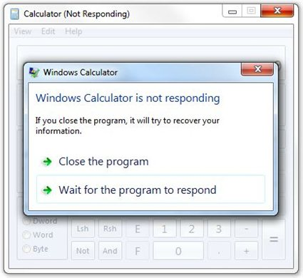
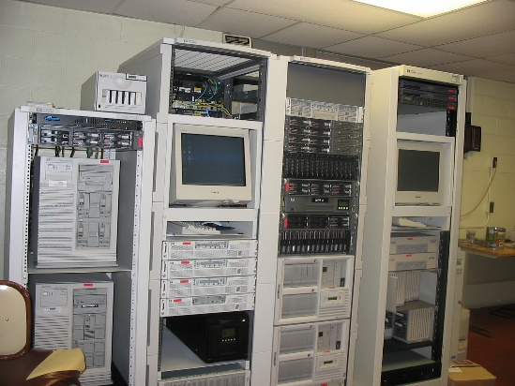

Legacy Systems
The way it used to be
Client (Desktop)
Server (On-Premises)
Notes:
Client: Blocking UI threads. One program freezes, not a big deal.
Server: Extra-sized hardware, single DB backend (acting as bottleneck).
Synchronous code was OK for its time.

Slide 9
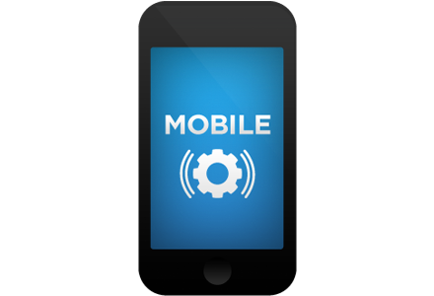
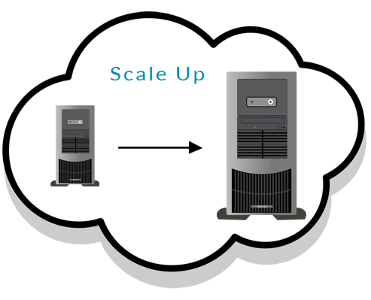

Modern Systems
The way of the future
Client (Mobile)
Server (Cloud)
Notes:
Client: Only one app! Can’t freeze it!
Benefit of asynchrony: responsiveness.
Server: Right-sized hardware, scalable backend.
Benefit of asynchrony: scalability, responsiveness to bursting traffic.
Cheaper hosting, better handling of sudden load.
Asynchronous code is quickly becoming a necessity in the modern mobile-first, cloud-first world.
We are living during a time of shift towards asynchronous code.

Slide 10
But it’s hard!
The problem with asynchrony: it’s hard!
Hard to:
Reason about
Write code
Debug
Understand and maintain the code!

Slide 11
Async is Awesome!
Note: functional languages (with macros) do not need async/await as a language feature.
The entire purpose of async/await is to make asynchrony easier.

Slide 12
Archaeology of Asynchrony
Async/Await
Futures / Continuations
Callbacks
Events
Time

Slide 13
In Case You Just Woke Up
Asynchrony is concurrency without threads.
Truly without threads. Not even OS or driver threads.
Benefits of asynchrony:
Responsiveness for clients (especially mobile).
Scalability for servers (especially cloud).
But asynchrony is hard. ☹
Languages are adopting async to make asynchrony easier. ☺
Notes:
Is Async still an invasion? Or is it more of a revolution now?

